Slide 1


Slide 2
Game Theory and Covid-19
Mohammad Javad Maheronnaghsh
Nima Najafi
Hooman Keshvari

Slide 3
Roadmap
Motivation
Supply
Chains
Cooperate
Other
Disasters

Slide 4
Roadmap
Motivation
Supply
Chains
Cooperate
Other
Disasters

Slide 5

What is a pandemic?

Slide 6
COVID-19 impacts
Education
Transportation
Supply chains

Slide 7
Methodology
Variational Inequalities
Generalized Nash Equilibrium

Slide 8
Variational Inequalities
Variational inequality theory is a powerful unifying methodology for the study of equilibrium problems.

Slide 9
VI problems
Traffic network equilibrium
Migration equilibrium
Financial equilibrium
Supply chain network
The internet

Slide 10
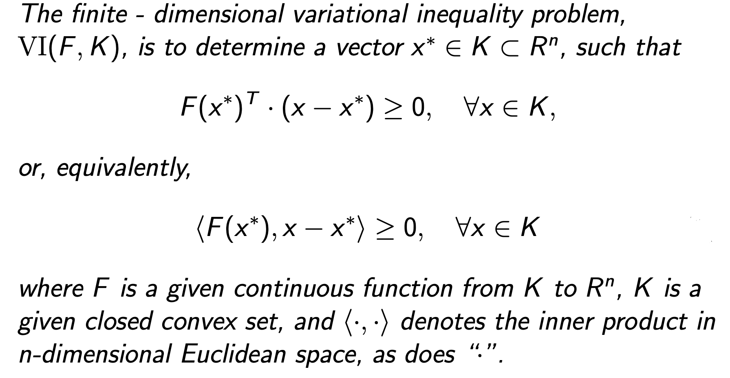
VI Definition

Slide 11
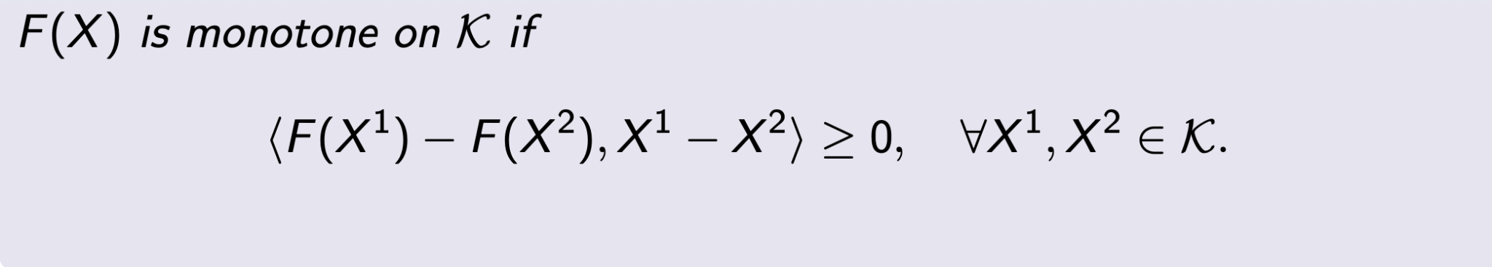
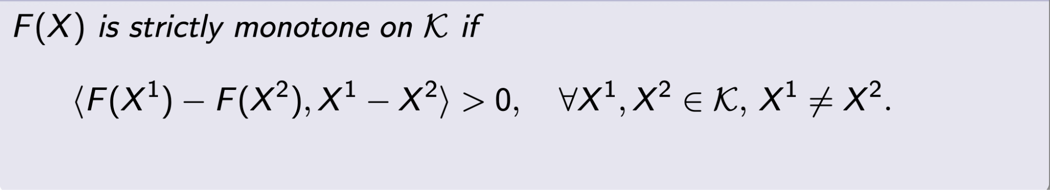
Monotonicity

Slide 12
Uniqueness and Existence of a Solution

Slide 13
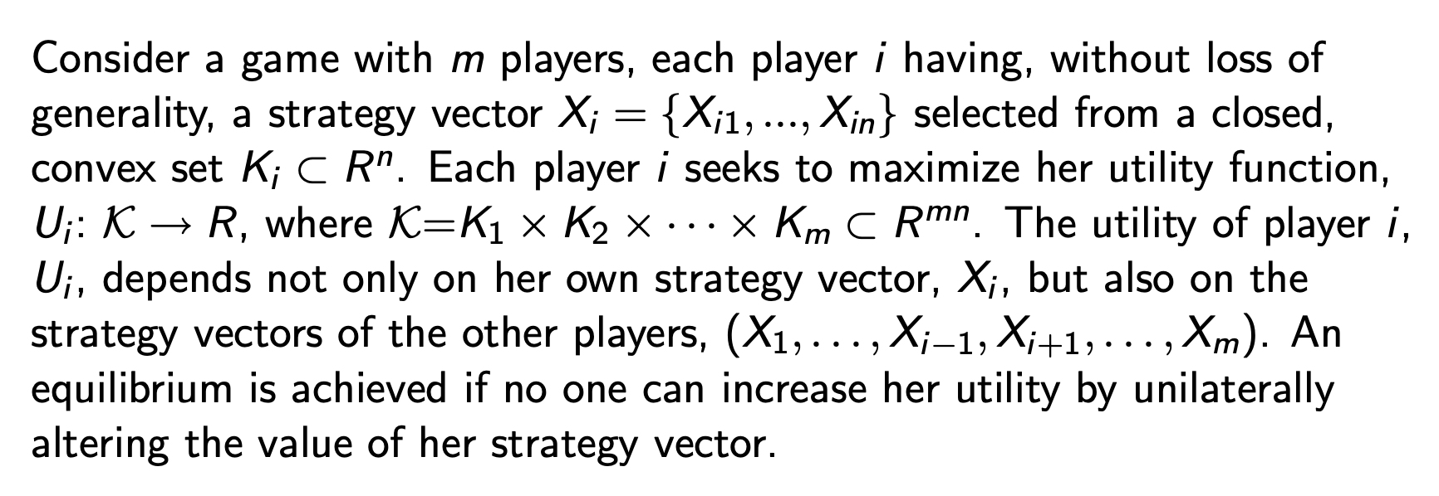
VI and Game Theory

Slide 14
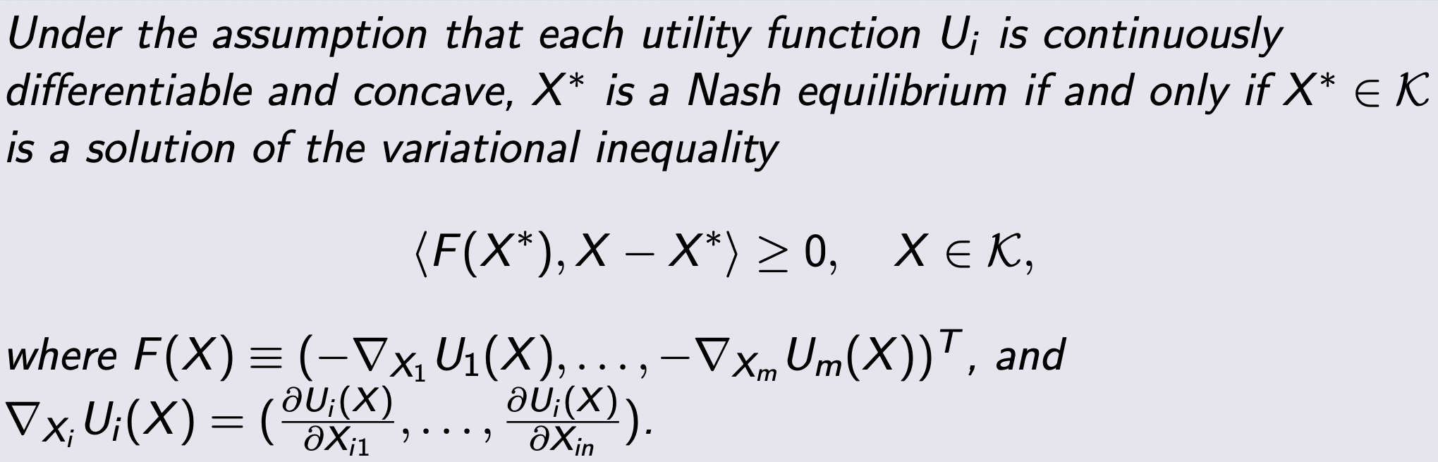
VI and Game Theory

Slide 15
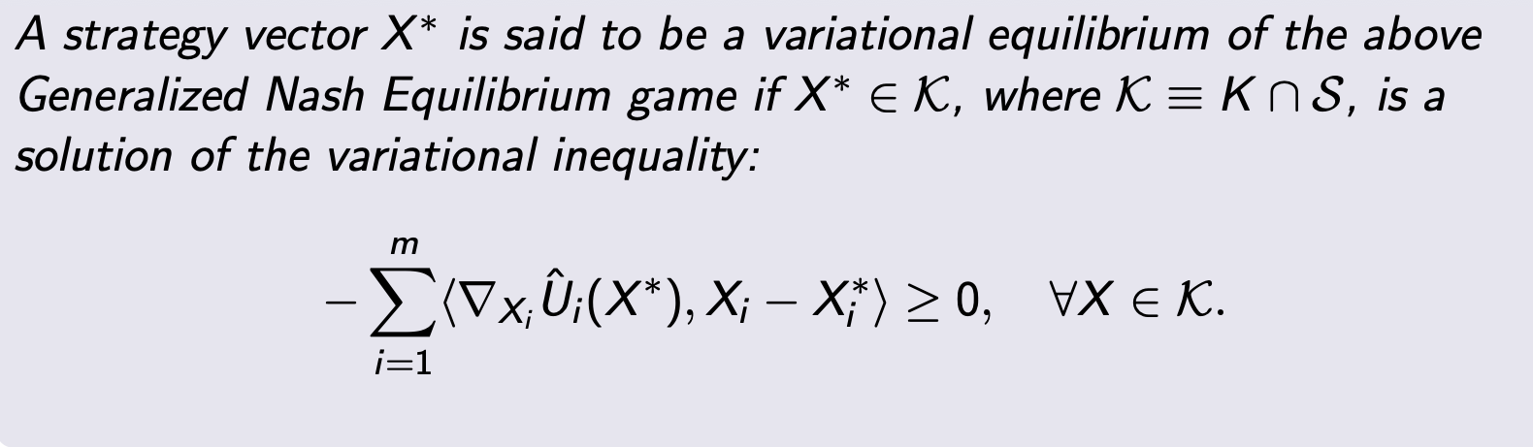
Generalized Nash Equilibrium

Slide 16
Roadmap
Motivation
Supply
Chains
Cooperate
Other
Disasters

Slide 17

Supply Chains
Definition
Networks
Chain Disruptions
Competitions

Slide 18
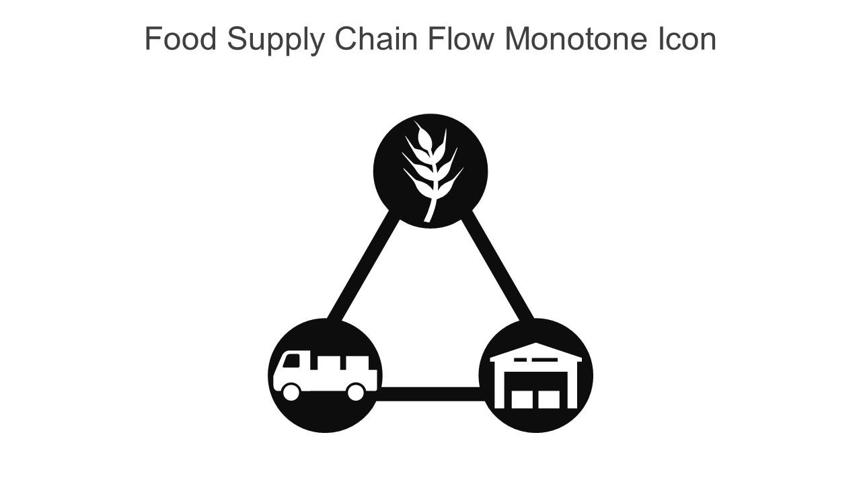
Food Chains
Covid Impact
Disruptions
Animals Culled
Shortage of Meat
Price Increase
Stop Fresh Production
Labor Problem
Food Insecurity

Slide 19
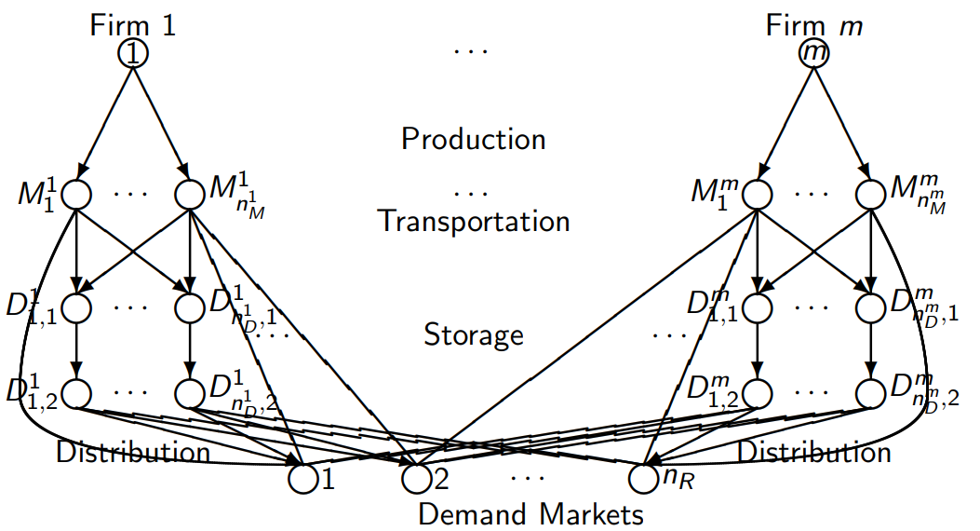
Food Network
Model Food Chain Network
Production
Transportation
Storage
Markets
Providers

Slide 20
Product System
Non-negative Flows
Links
Constraints
Optimization Problem
Maximize Profit
Firms Compete
Max Flow Problem

Slide 21
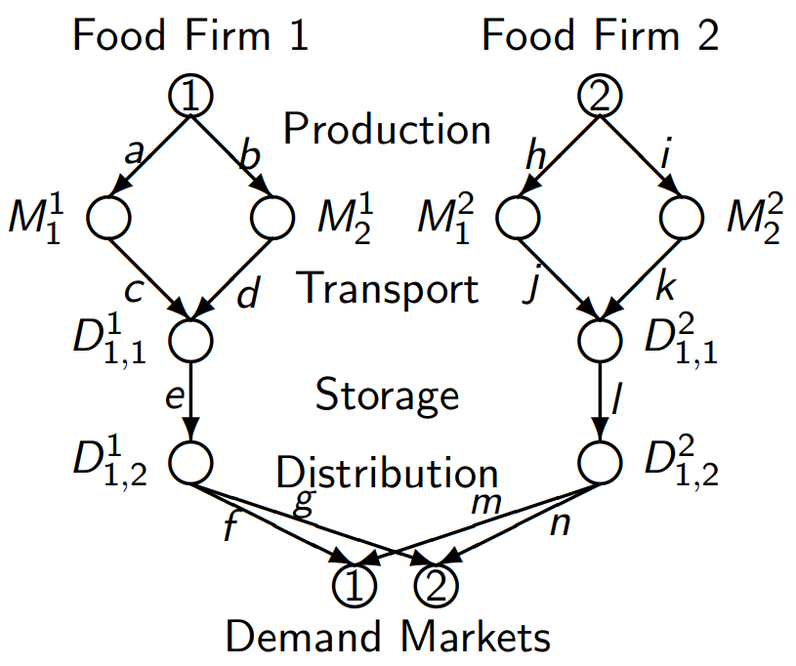
Farm Example
Blueberry Farms
Demand/Price
Labor Disruptions
Operational Costs
Price Equilibrium
Link Reduction

Slide 22
Farm Results
Secure Worker Health
Profits Suffer
Worker Impacts Bottom
Wage-Labor Equilibrate
No Wage Ceilings

Slide 23

Medical Chains
Healthcare Disaster
Needs Arise
N95 Mask
Competition
Price Increase

Slide 24
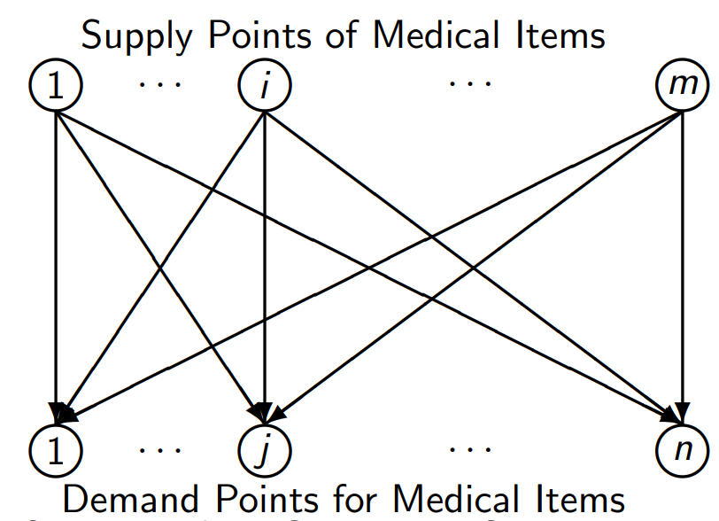
Medical Network
Limited Capacities
Uncertain Demands
Global Costs
General Nash Equilibrium
Strategy of Suppliers

Slide 25
Medical System
Shortage/Surplus
Minimize Costs
Constraints
General Transport Cost
Equilibrium
No Demand Change
Stochastic Demands

Slide 26

Mask Example
N95 Masks
Increase Demand
Competition

Slide 27
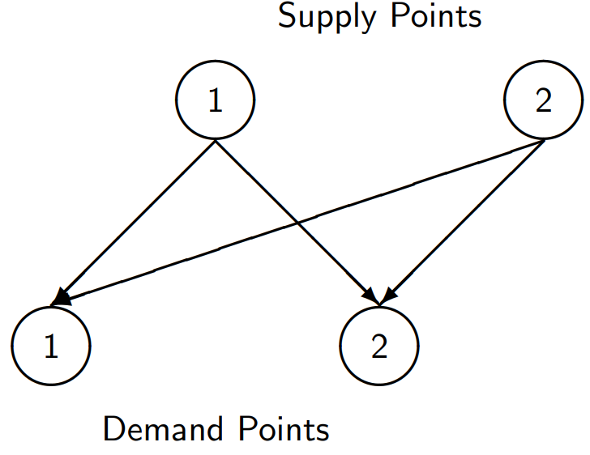
Mask Chain
Intense Demand
Fully Sold Out
Increasing Supply
Secure Demands

Slide 28
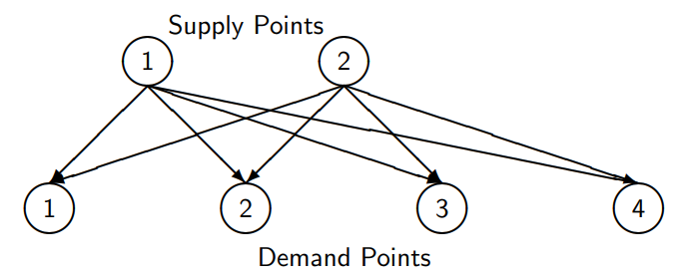
Mask Results
More Supplier Needed
Local Production
Long Term Economics

Slide 29
Chain Conclusion
Chains
Examples
Results

Slide 30
Roadmap
Motivation
Supply
Chains
Cooperate
Other
Disasters

Slide 31
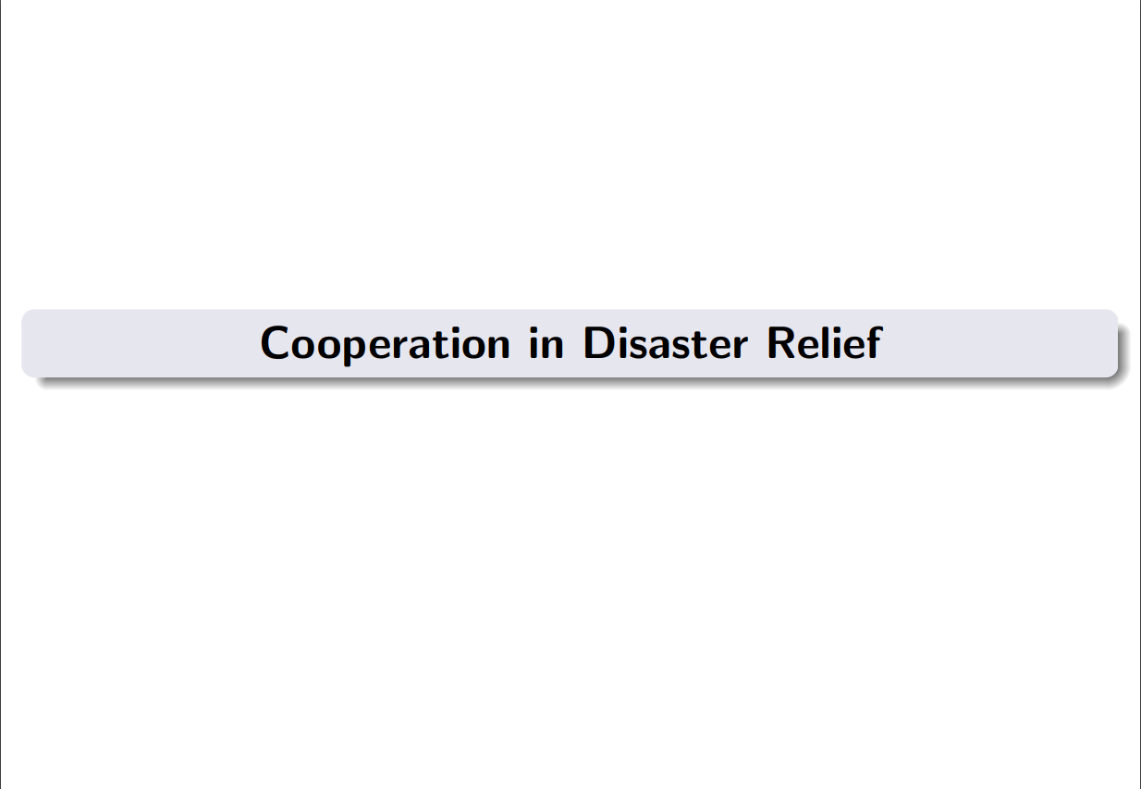

Slide 32
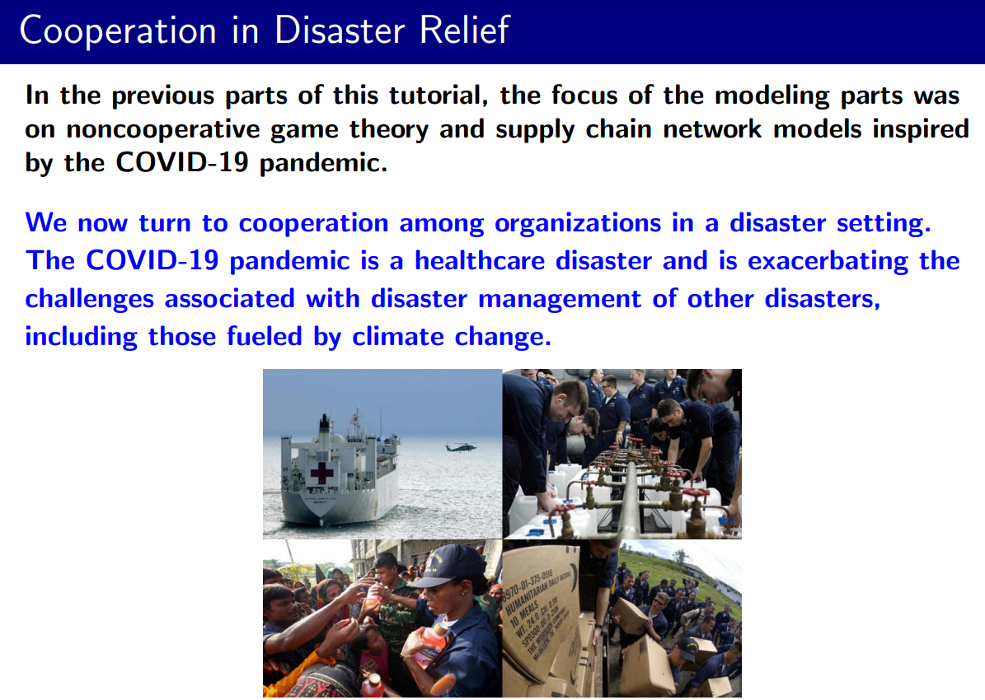

Slide 33
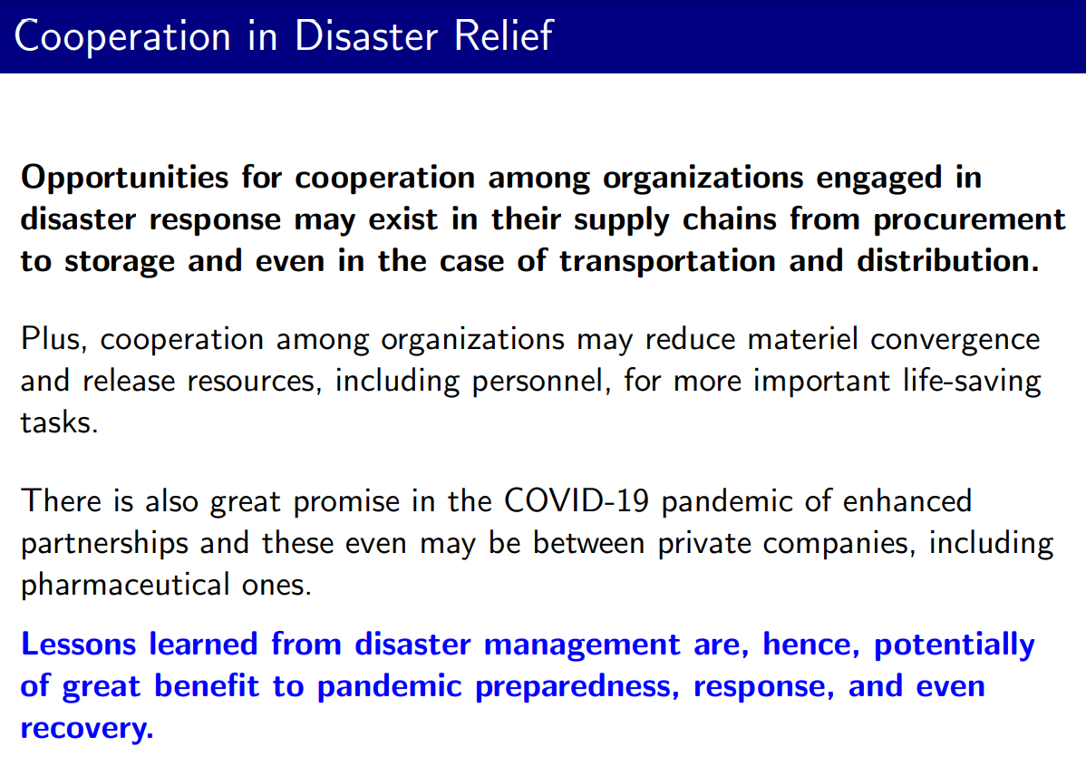

Slide 34
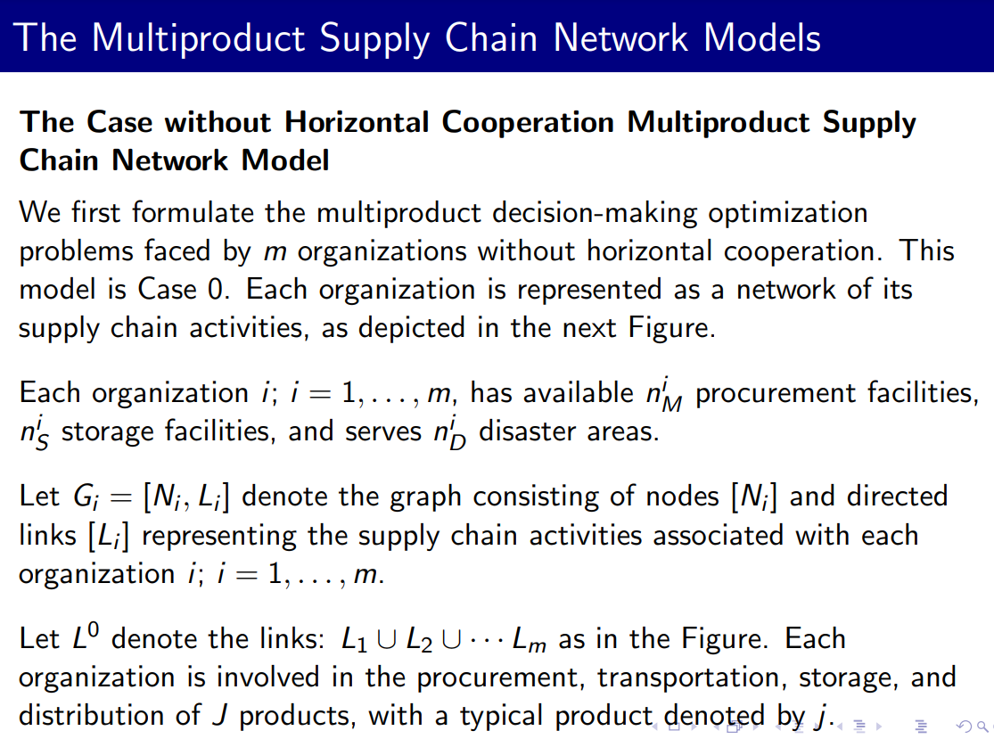

Slide 35
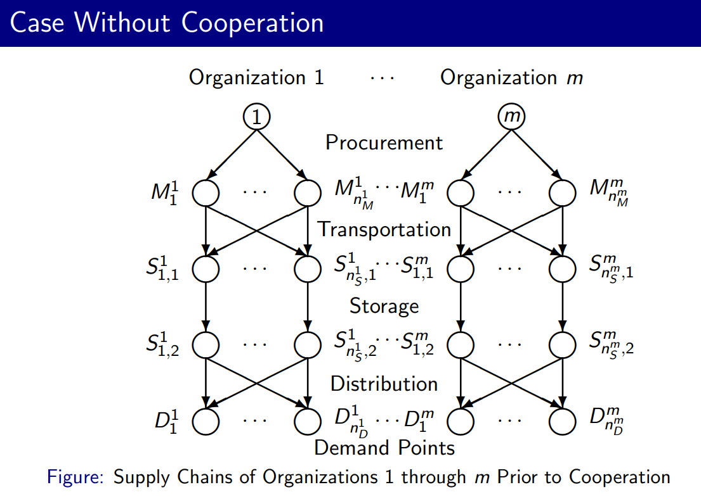

Slide 36
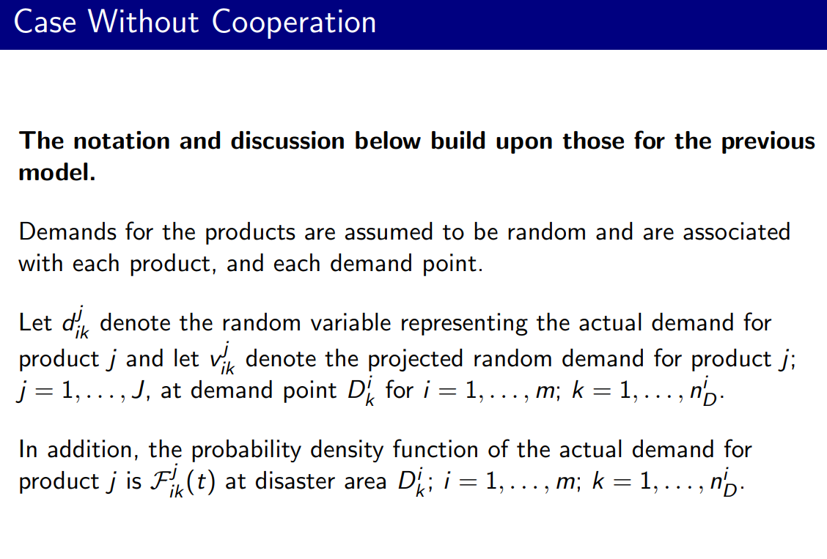

Slide 37
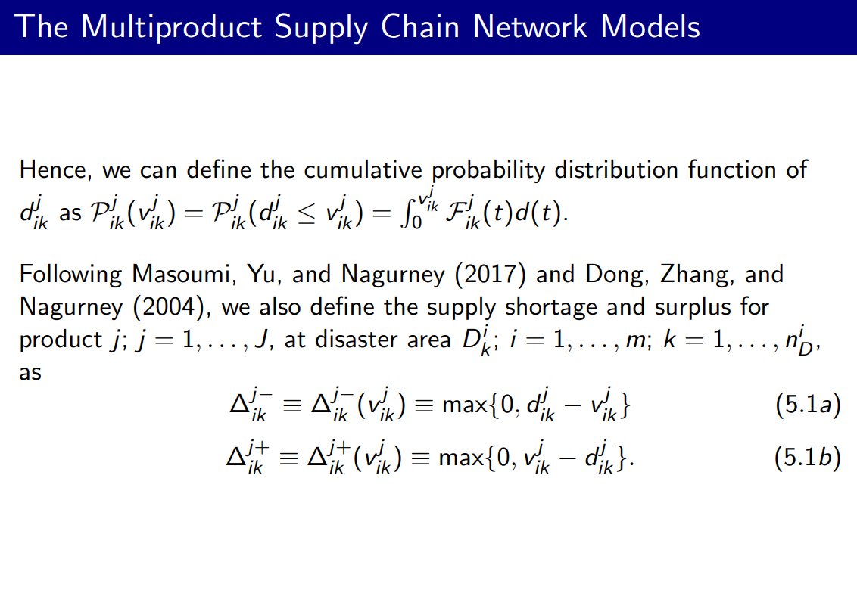

Slide 38
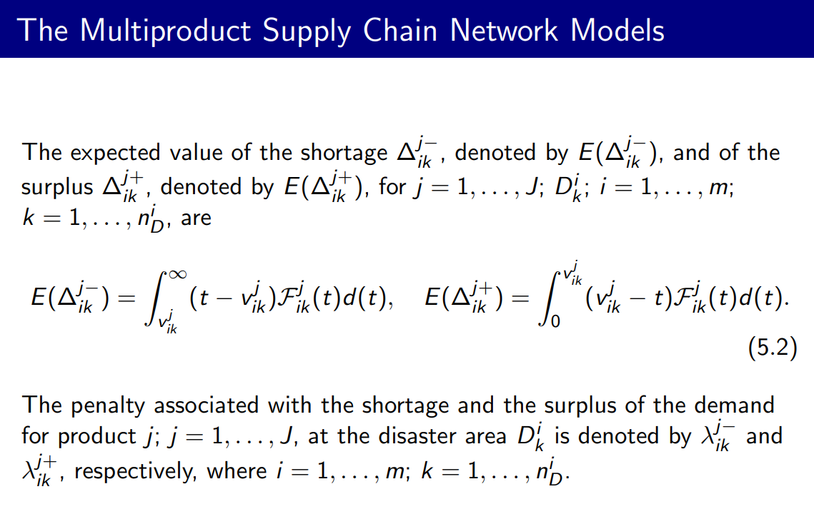

Slide 39
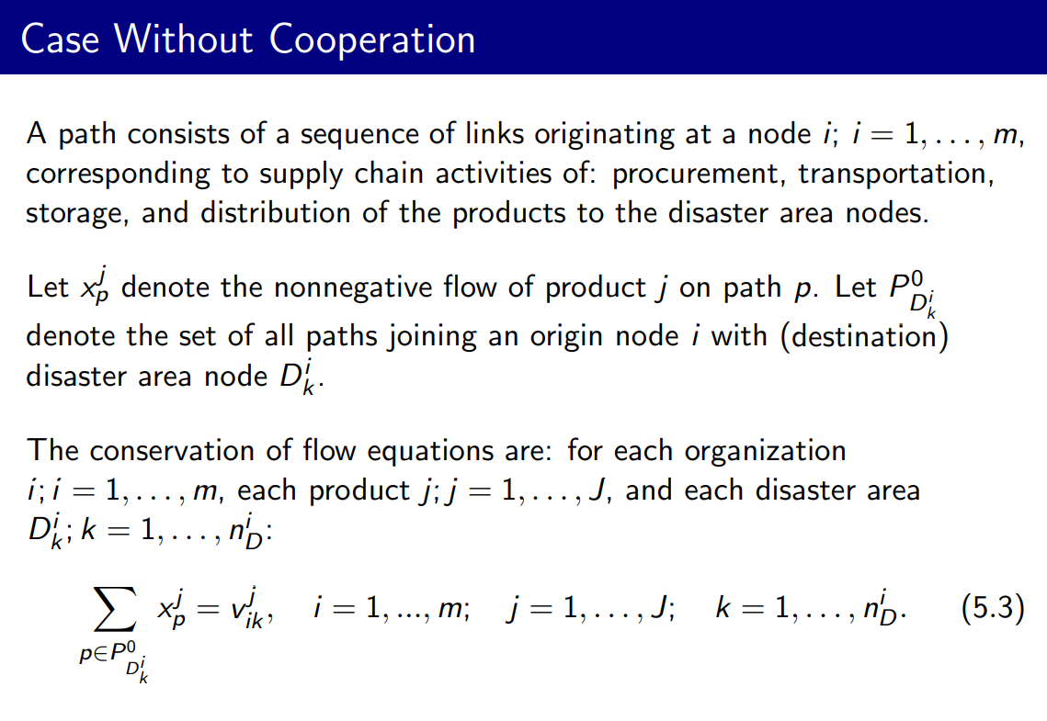

Slide 40
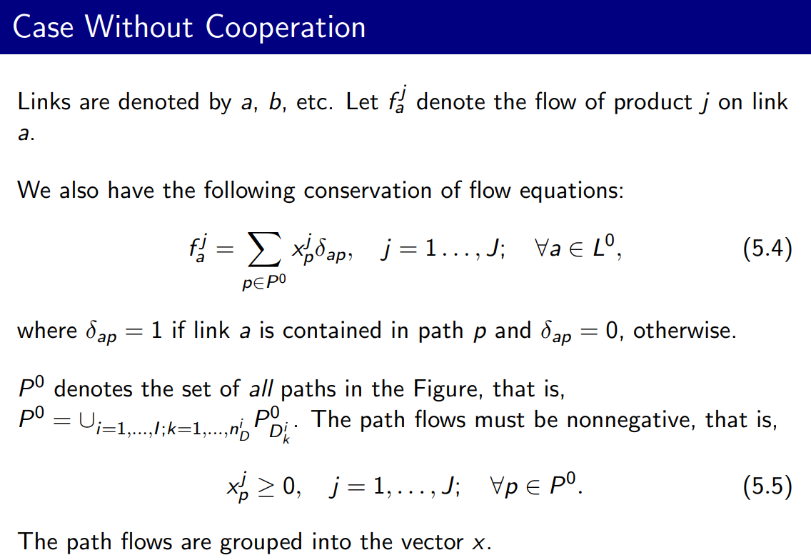

Slide 41
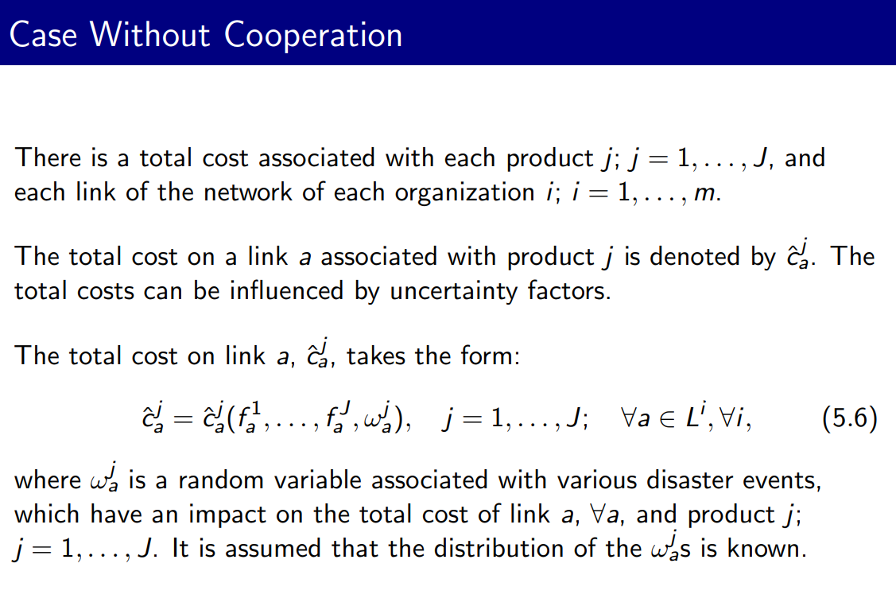

Slide 42
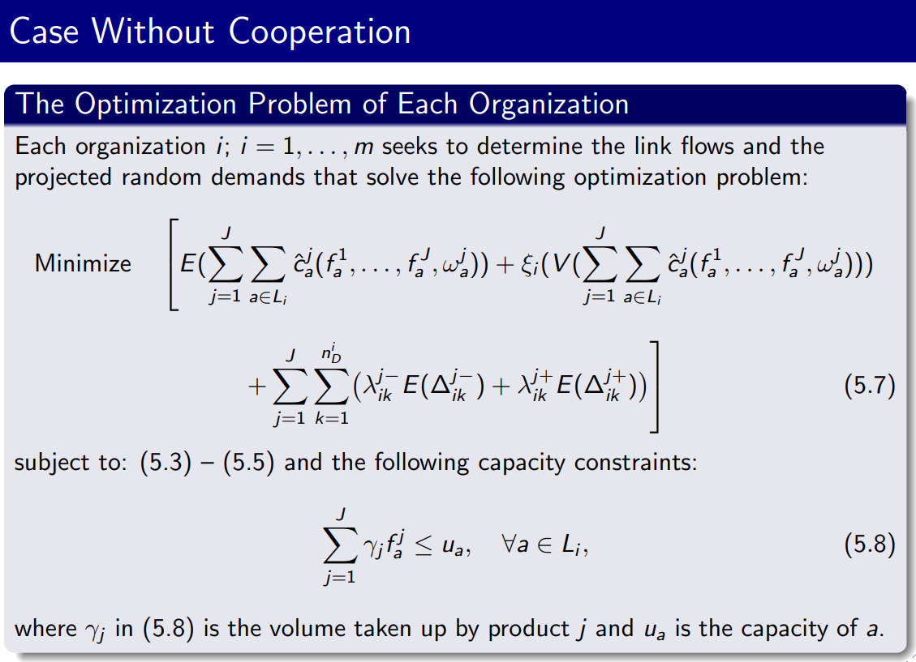

Slide 43
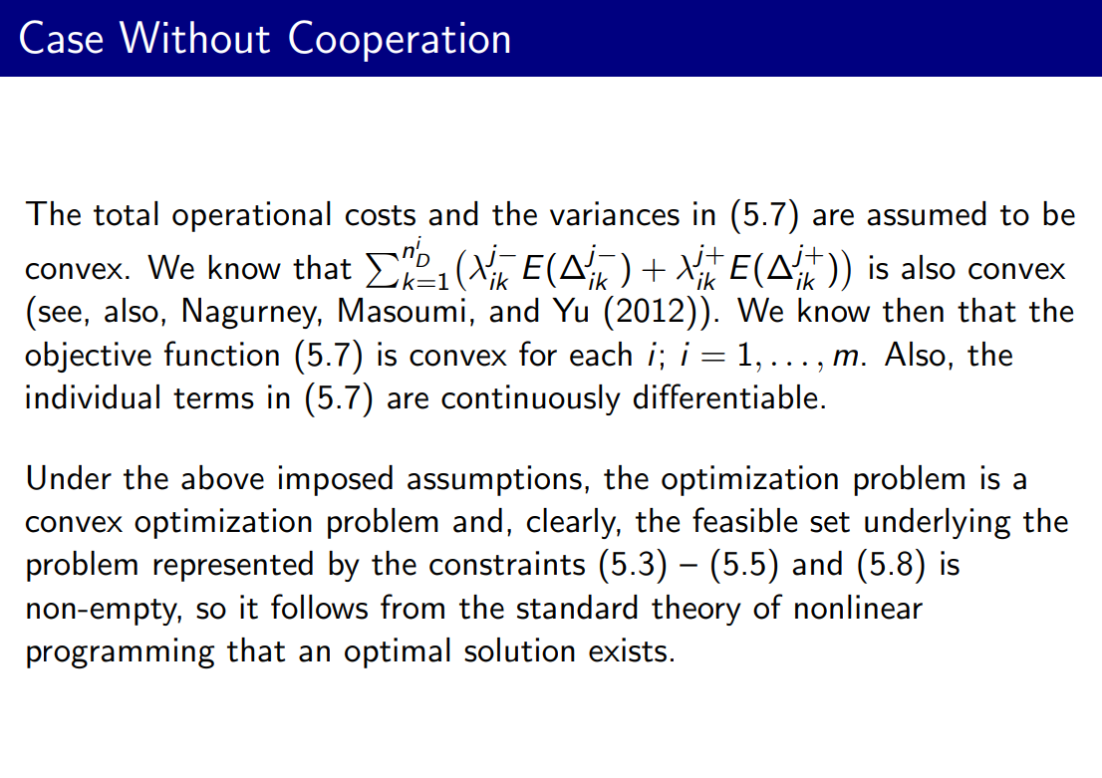

Slide 44
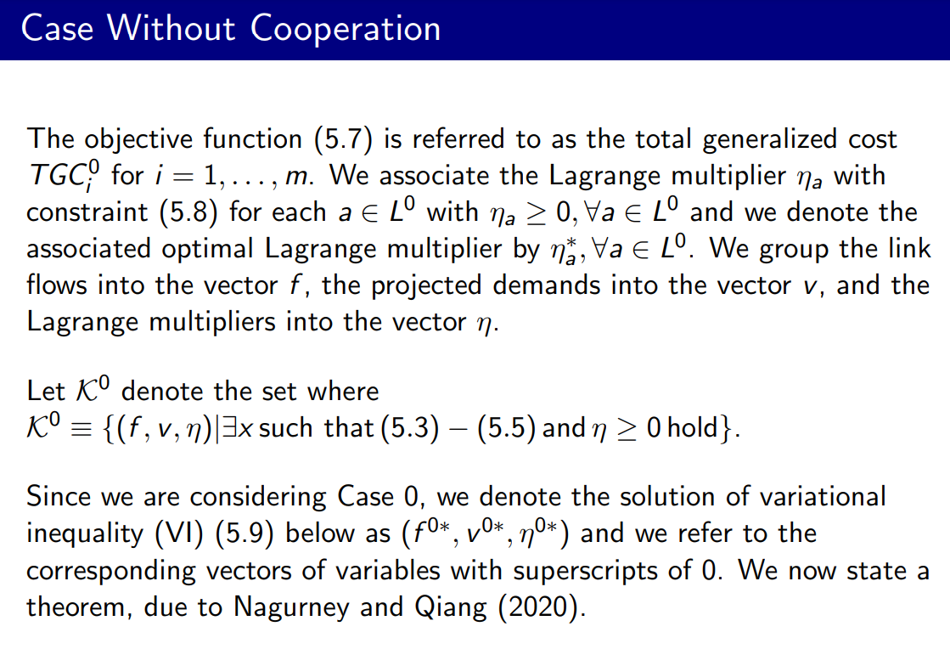

Slide 45
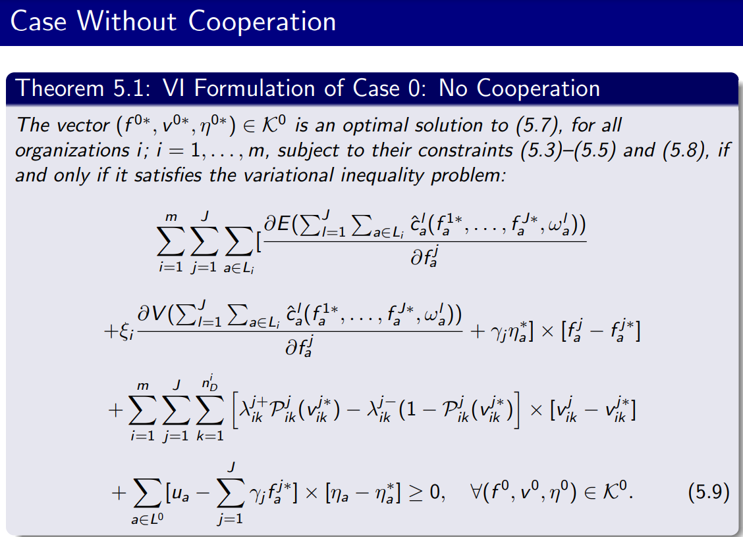

Slide 46
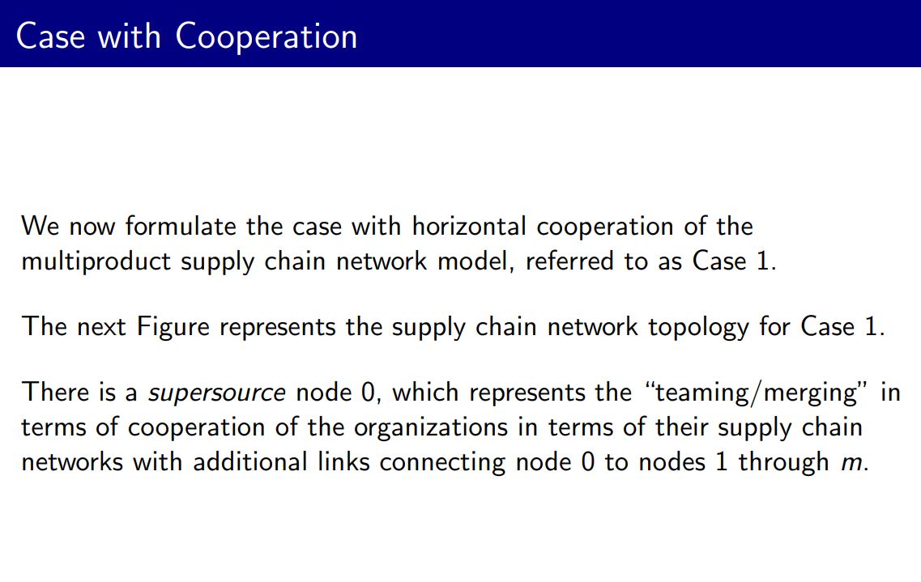

Slide 47
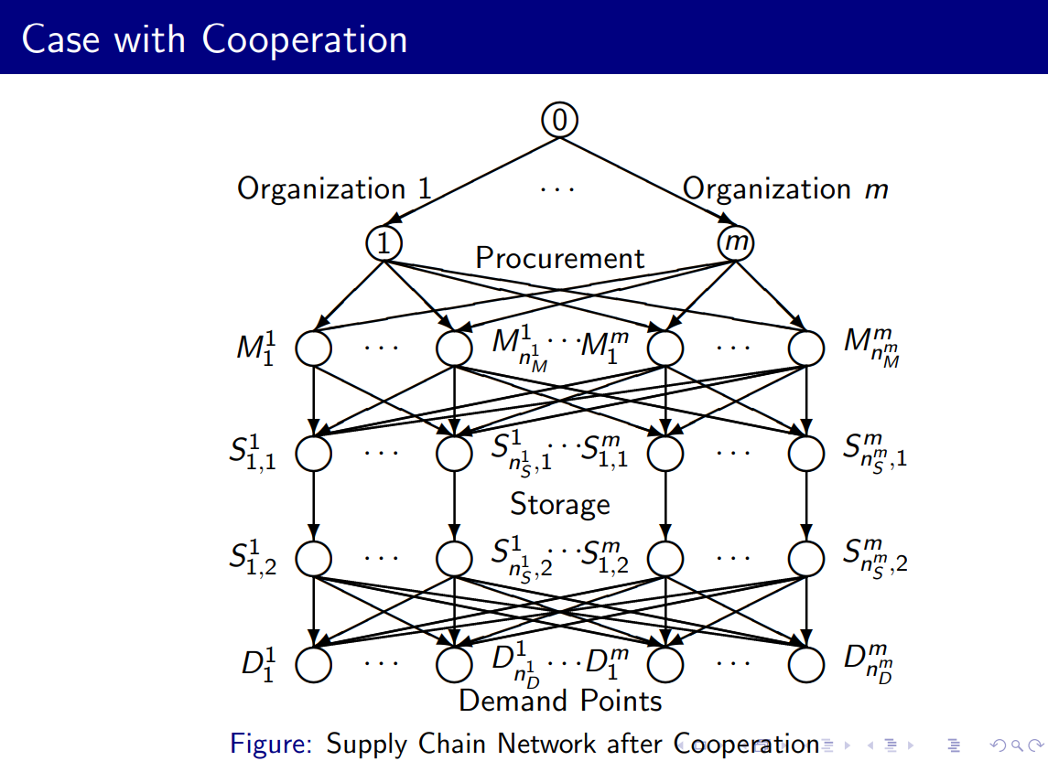

Slide 48
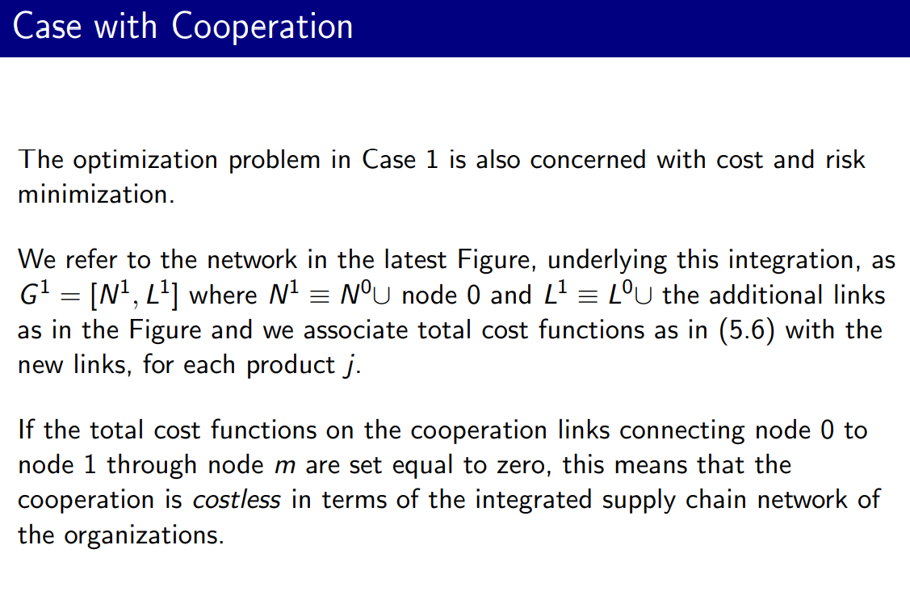

Slide 49
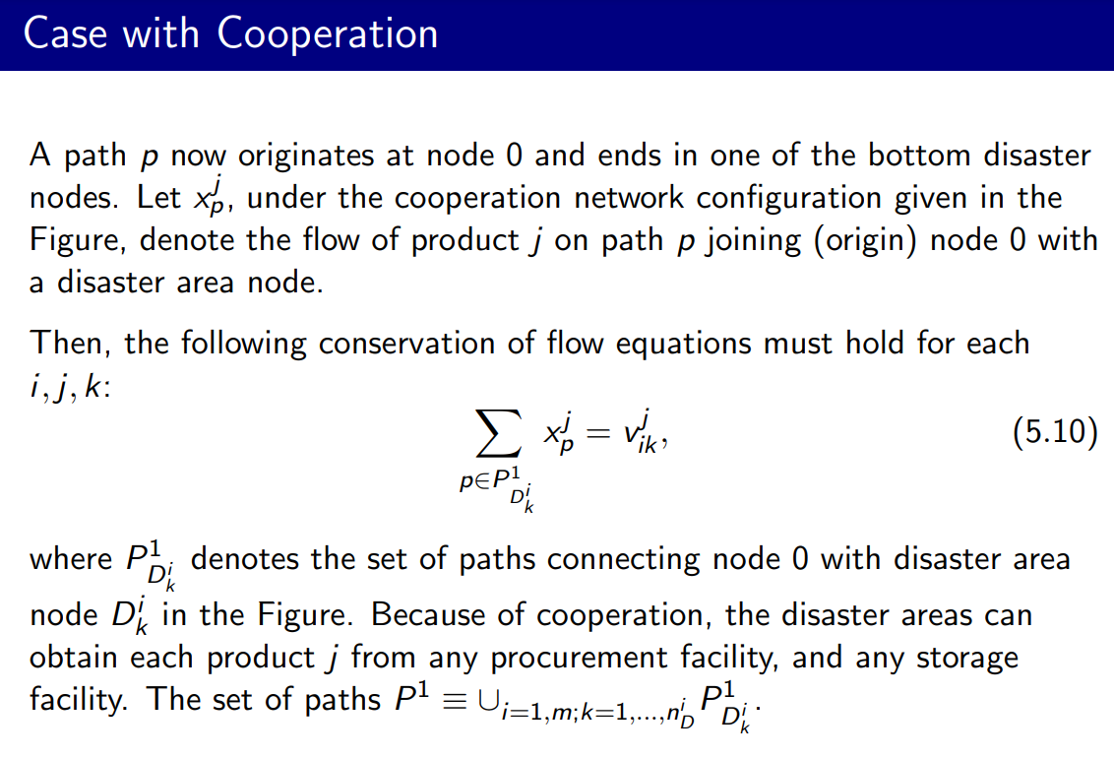

Slide 50
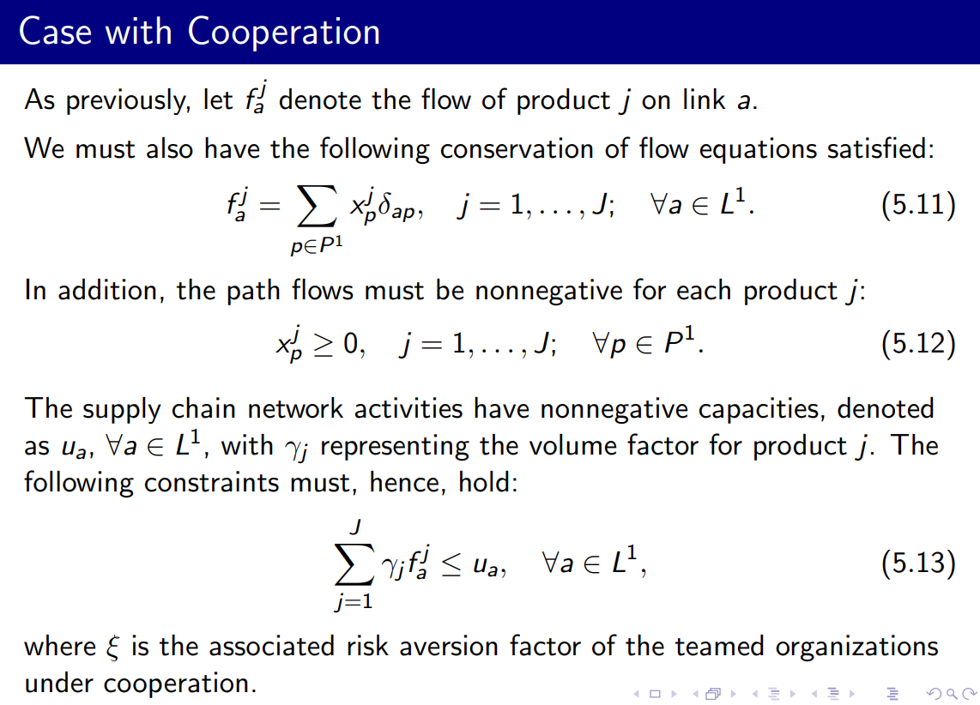

Slide 51
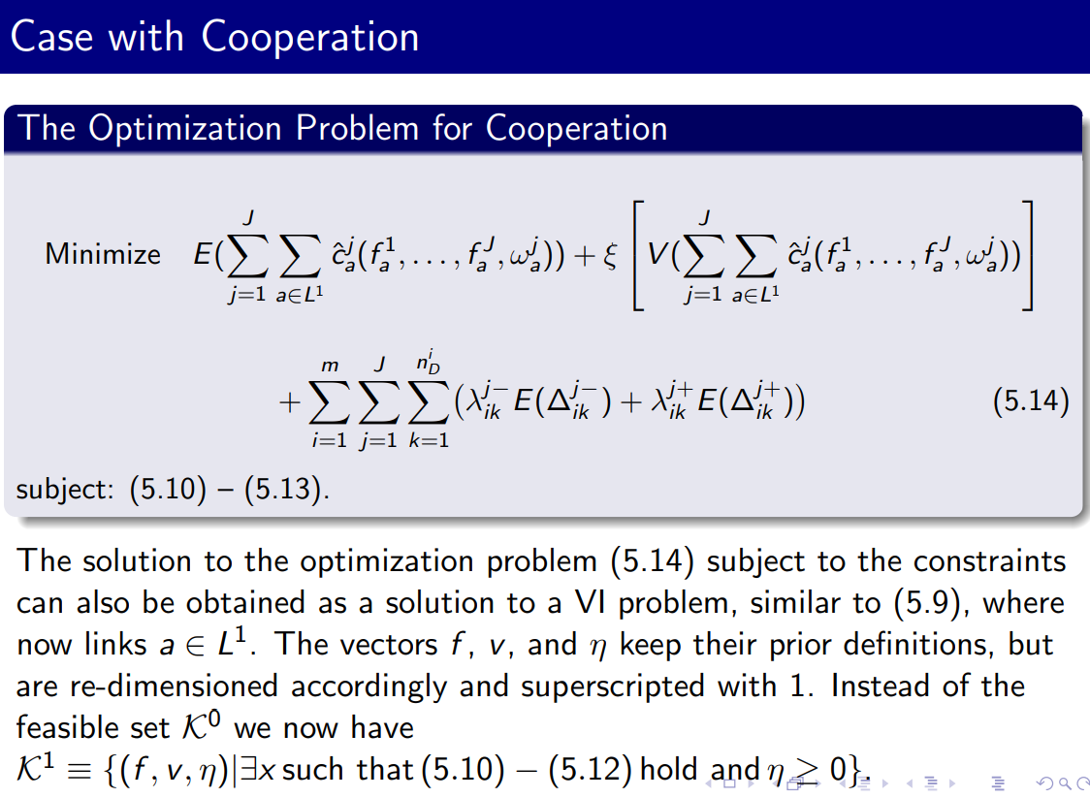

Slide 52
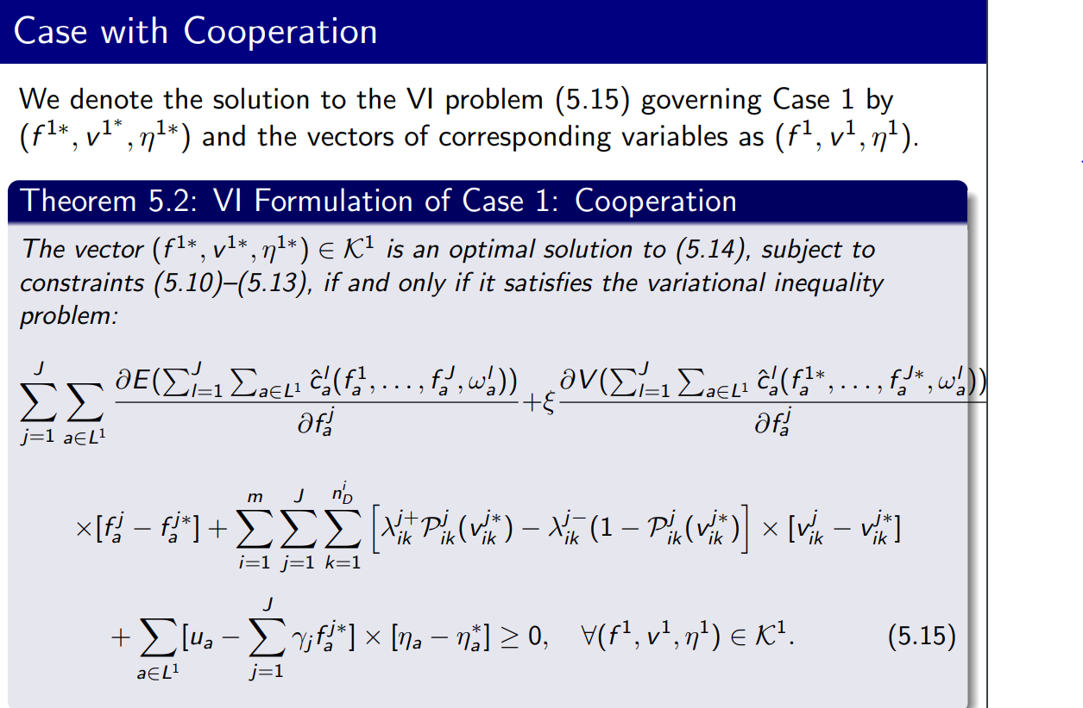

Slide 53
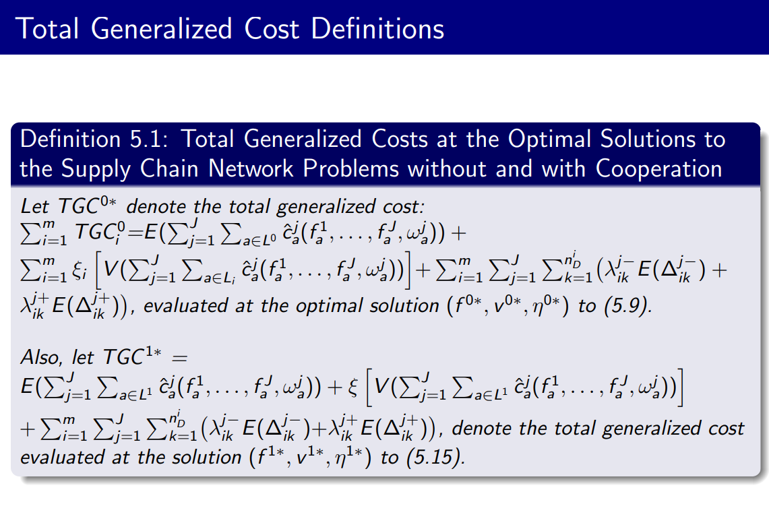

Slide 54
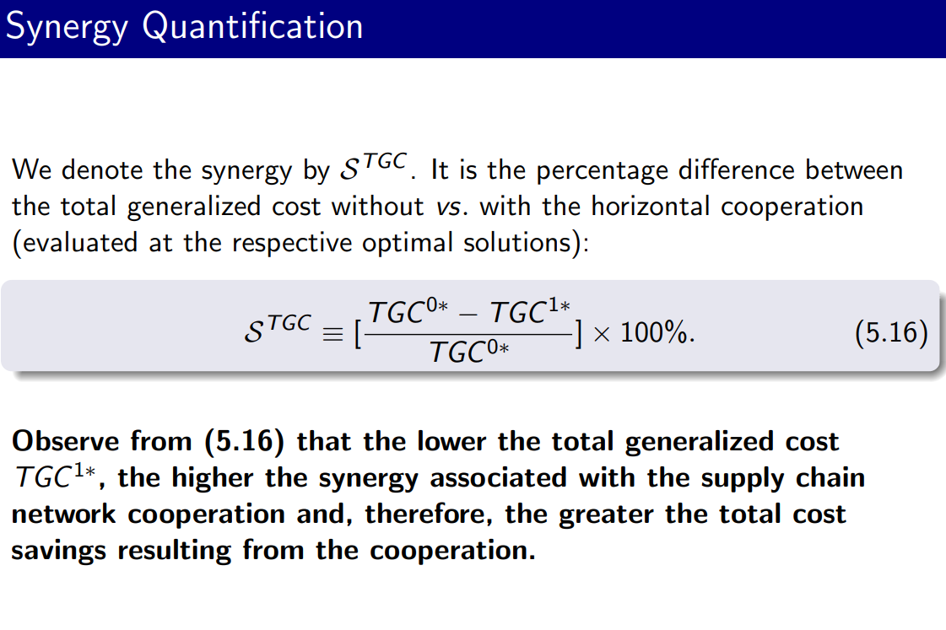

Slide 55
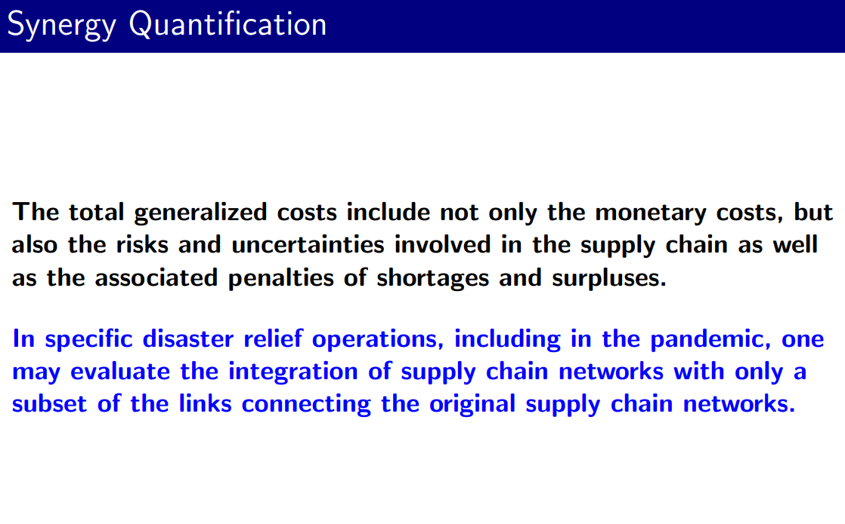

Slide 56
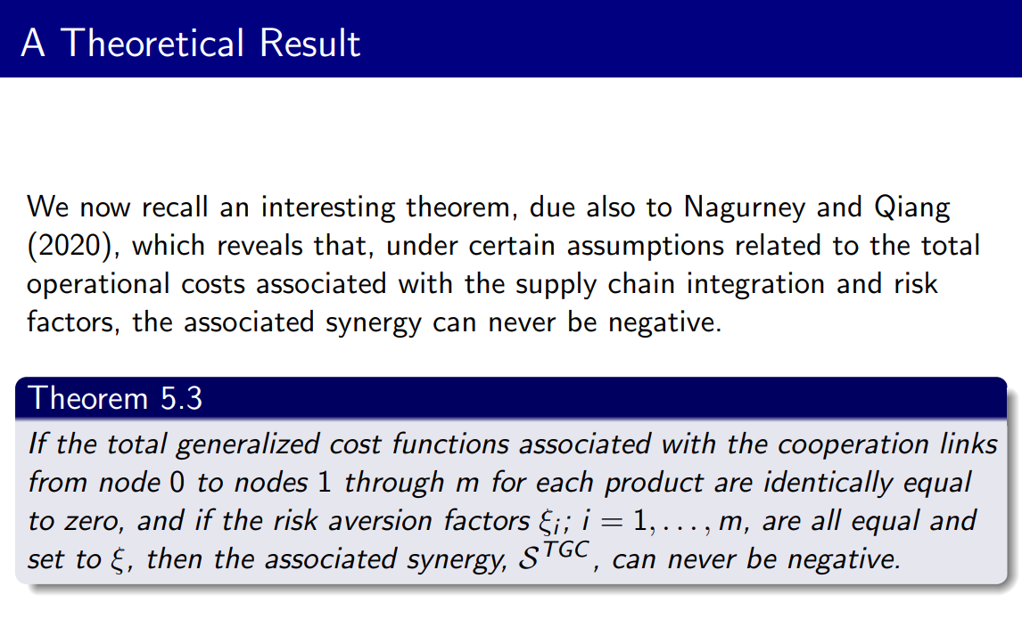

Slide 57
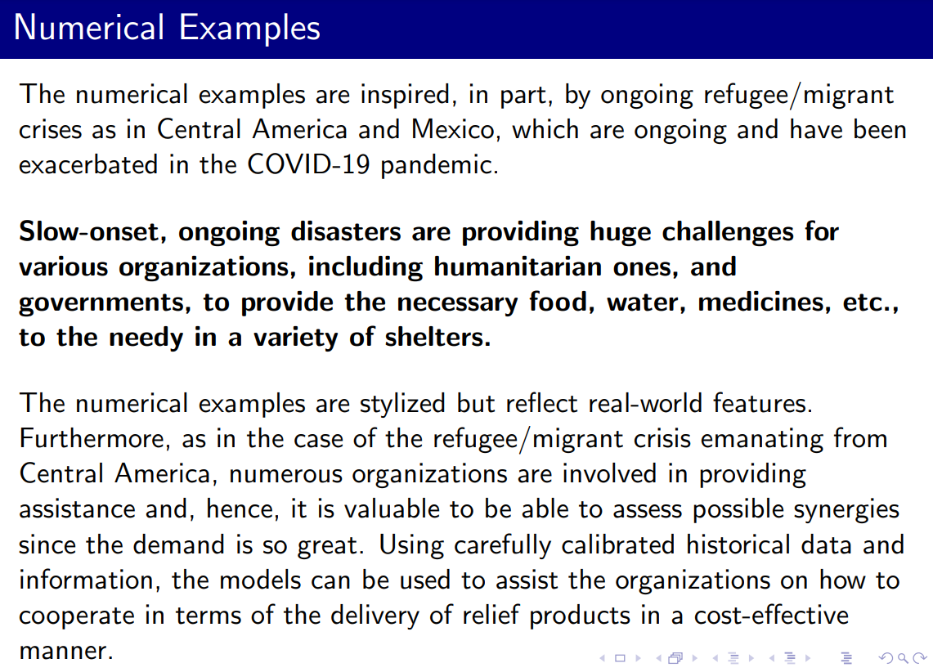

Slide 58
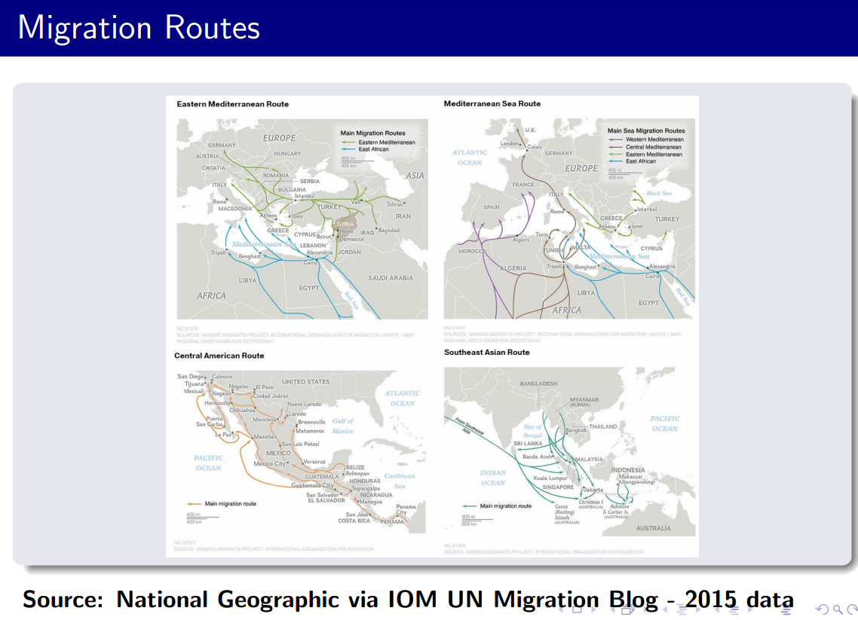

Slide 59
Roadmap
Motivation
Supply
Chains
Cooperate
Other
Disasters

Slide 60
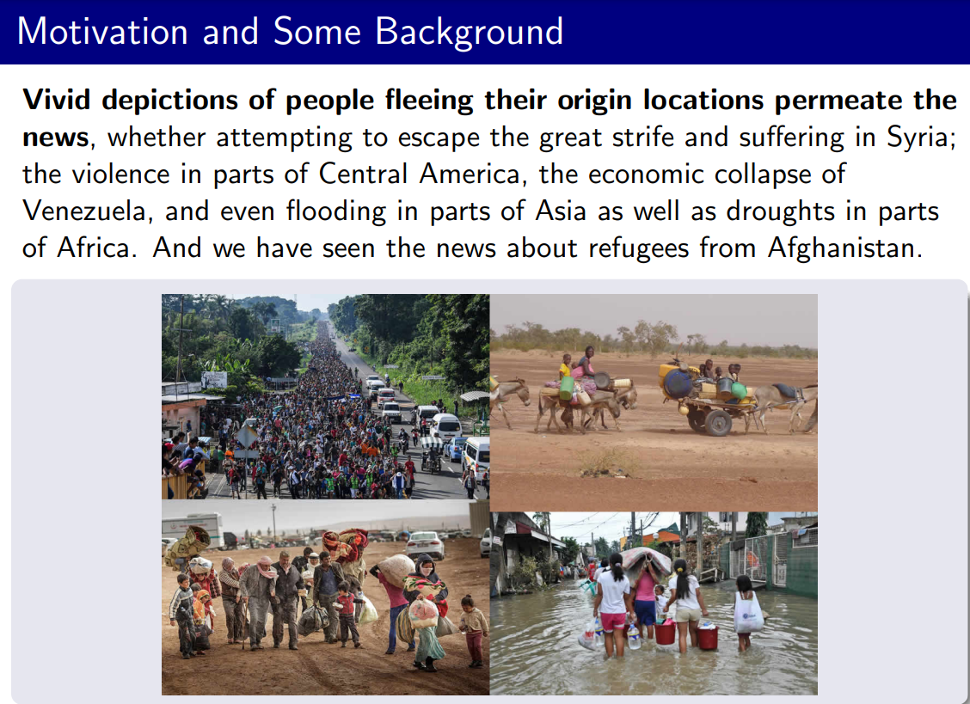

Slide 61
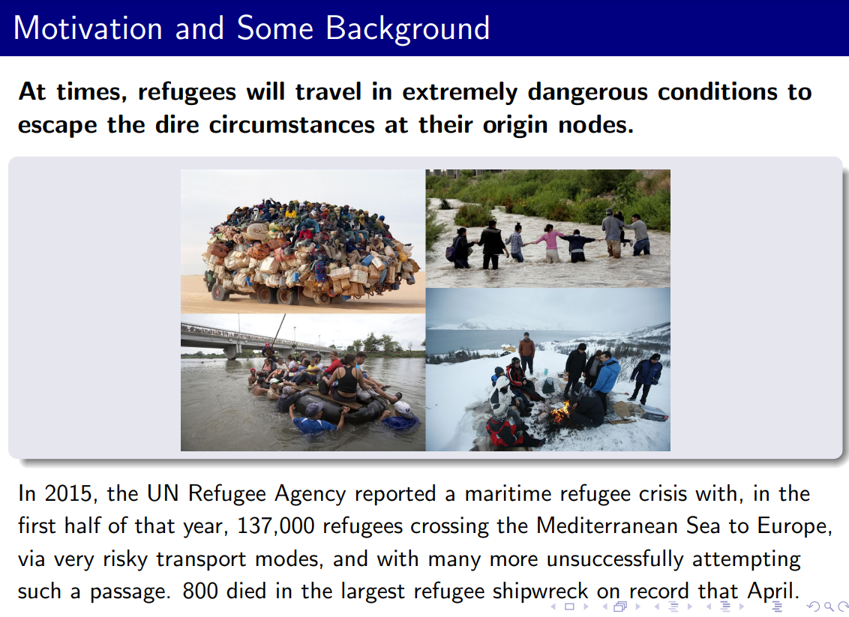

Slide 62
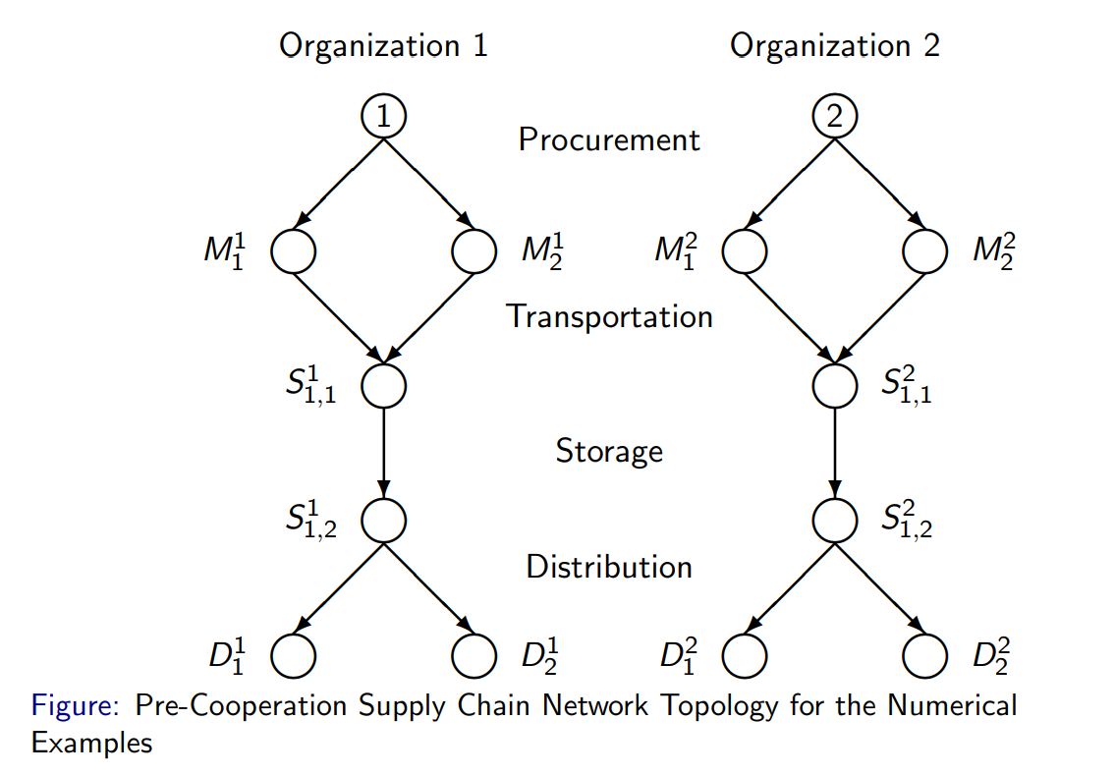

Slide 63
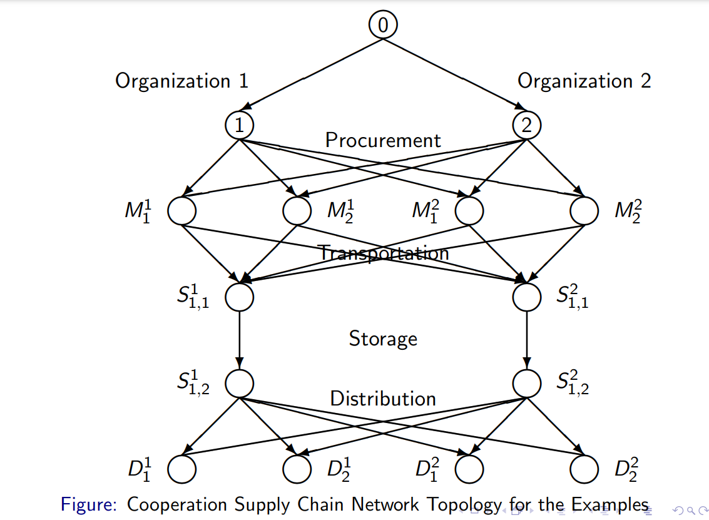

Slide 64
Conclusions
Motivation
Supply
Chains
Cooperate
Other
Disasters

Slide 65
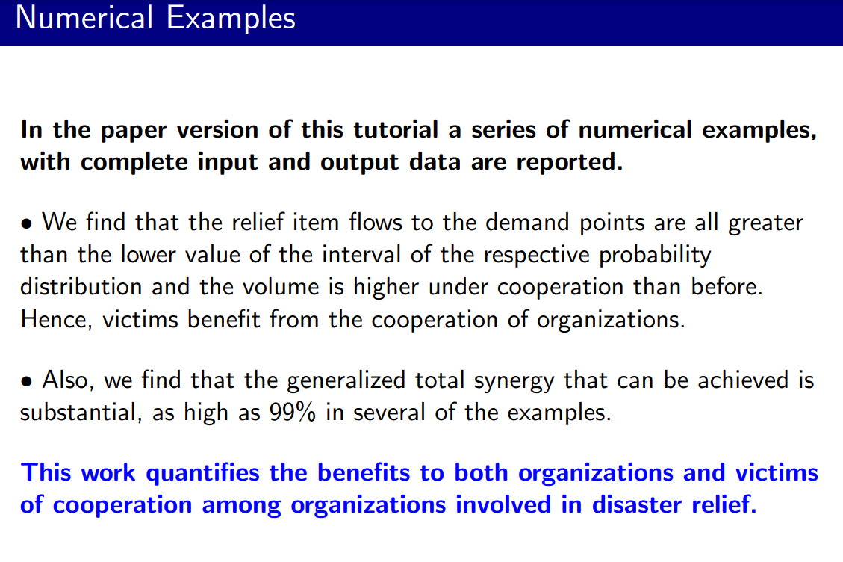

Slide 66
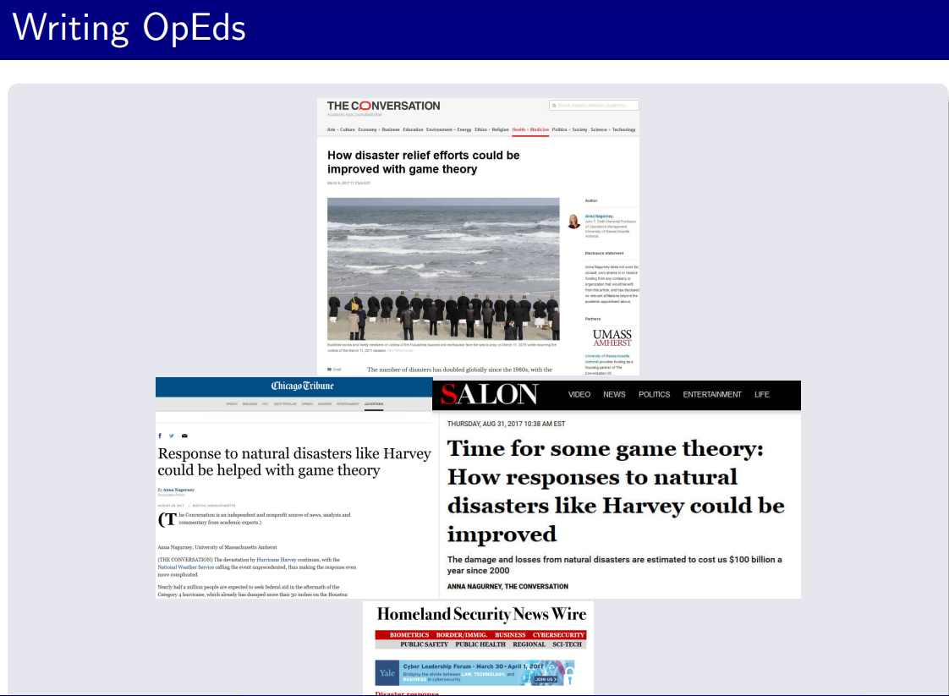

Slide 67
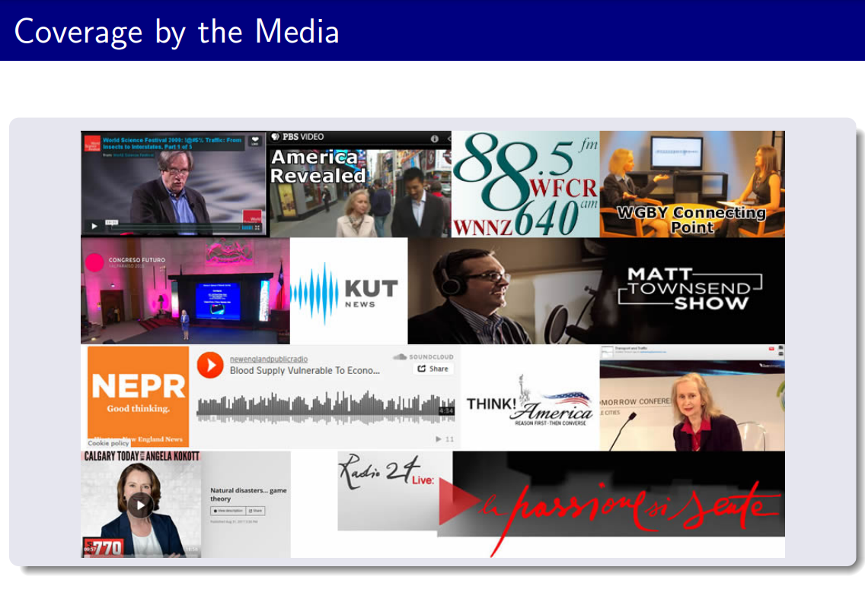

Slide 68


Slide 69
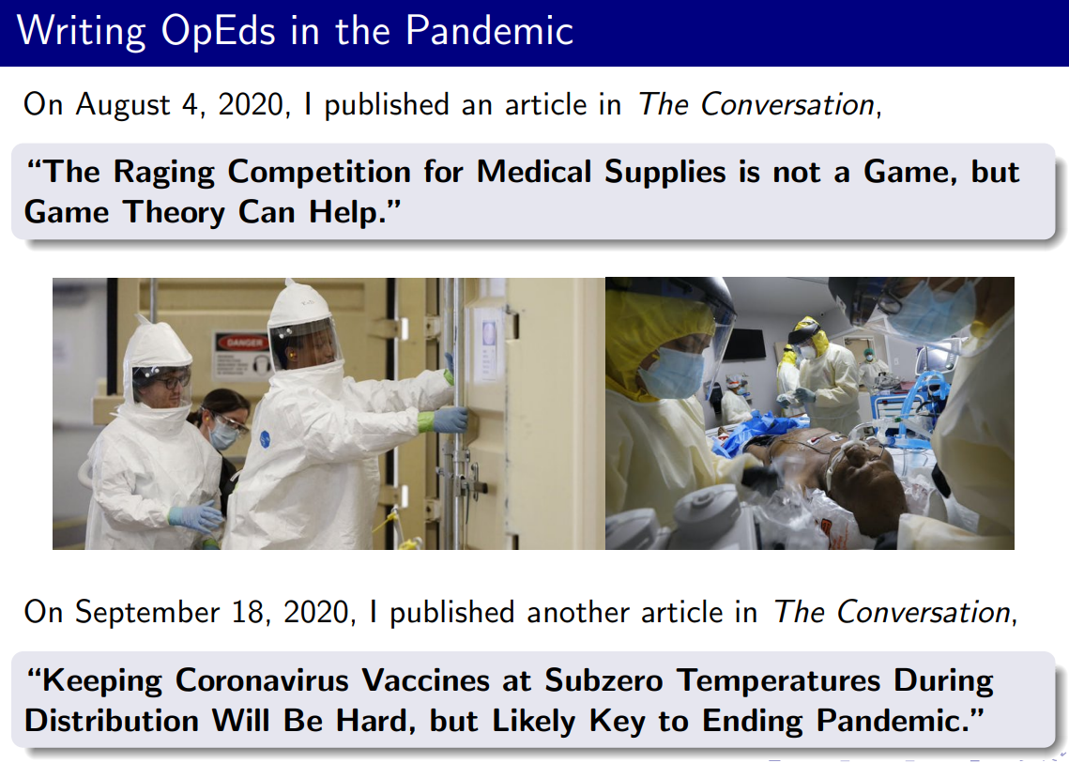

Slide 70
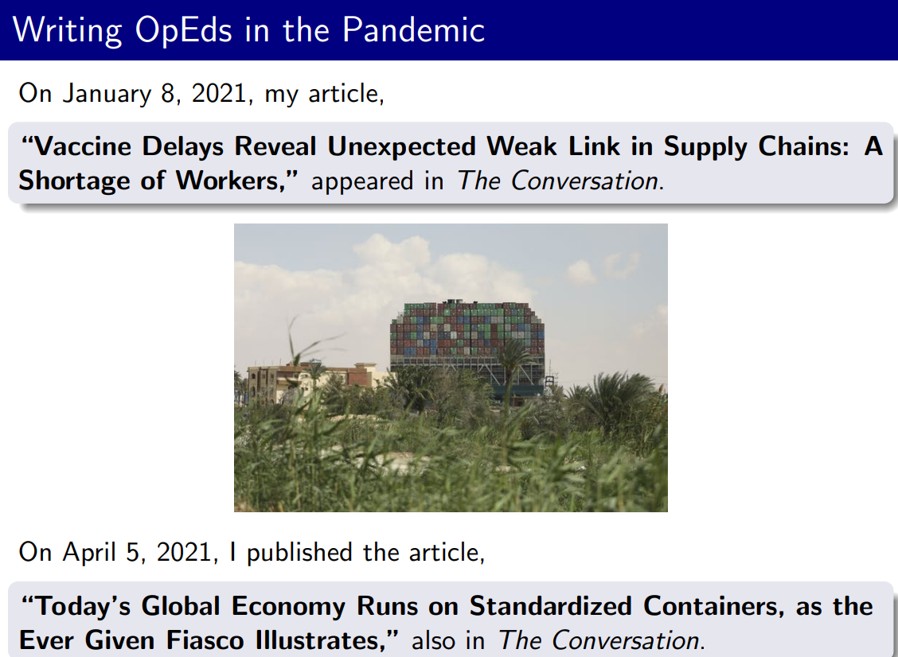

Slide 71

با تشکر

Slide 72
Resources
Covid-19 And Game Theory
Covid-19 And Game Theory Video

